Slide 1
Lead Scoring Case Study
SUMIT RAGHUVANSHI
VIBHAV MANN

Slide 2
Objective:
X education wants to know most promising leads.
For that they want to build a Model which identifies the hot leads.
Deployment of the model for the future use.
Problem Statement:
X Education sells online courses to industry professionals.
X Education gets a lot of leads, its lead conversion rate is very poor. For example, if, say, they acquire 100 leads in a day, only about 30 of them are converted.
To make this process more efficient, the company wishes to identify the most potential leads, also known as ‘Hot Leads’.
If they successfully identify this set of leads, the lead conversion rate should go up as the sales team will now be focusing more on communicating with the potential leads rather than making calls to everyone.

Slide 3
Analysis Approach:
Data Collection And Data Cleaning: Importing the data then cleaning it , checking if there are any null values. We found out that some columns were in lead score data form so corrected them using the correct formulas.
EDA: Univariate data analysis: value count, distribution of variable etc.
Bivariate data analysis: correlation coefficients and pattern between the variables etc.
Visualizing data: We detected outliers by visualizing the data , outliers were treated according to our problem statement. We also found out that some Variables are highly corelated to each other.
Outliers Detection and treatment: There were outliers in some columns. Some outliers like in Total Visits and Page views per visit column for example, have outliers on high end of spectrum which we can remove safely. For this analysis we capped those column at .95 quantile at upper end and .1 quantile at lower end. We did not capped other variable because that would effect our analysis for rest of the data.
Feature Scaling & Dummy Variables and encoding of the data.
Classification technique: logistic regression used for the model making and prediction.
Validation of the model.
Model presentation.
Conclusions and recommendations.

Slide 4
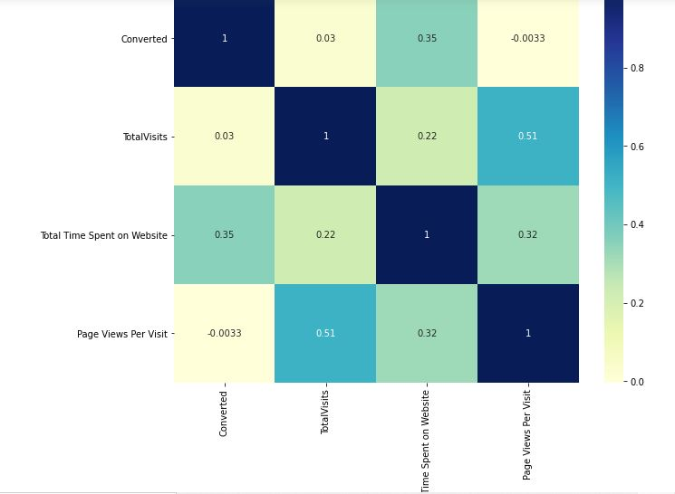
Data visualizations Correlation of the variables:
After the cleaning and dropping the columns, we checked the correlations between the rest numeric columns.
The highest correlation is Total Visits with Total Time Spent on Website.
Converted with Page Views Per Visit is negatively correlated with each other.
Total visits with the converted is the lowest correlation between them.

Slide 5
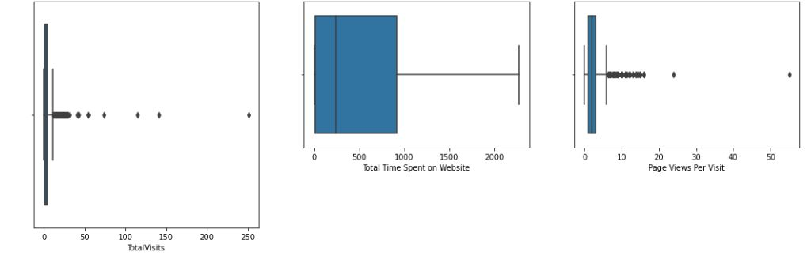
Visualization of Outliers
From the boxplots attached on the left, points to be concluded –
As we can see that all the boxplots created for the variables are having decent amount of outliers.
All boxplots except one ‘Total time spent on website’ is having least outliers on the bottom of the boxplots.
The Imports boxplot is having very thin size of quartiles compared to others.

Slide 6
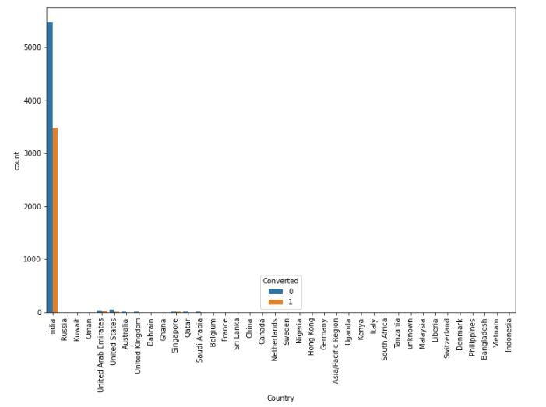
EDA (Data Visualizations)

Slide 7
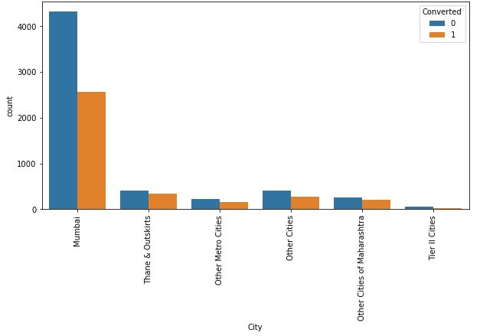
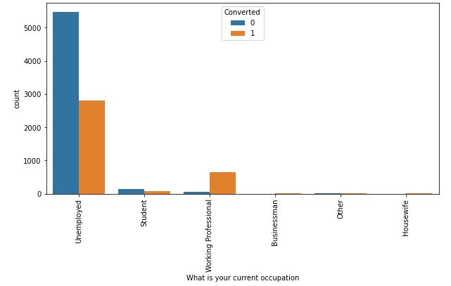

Slide 8
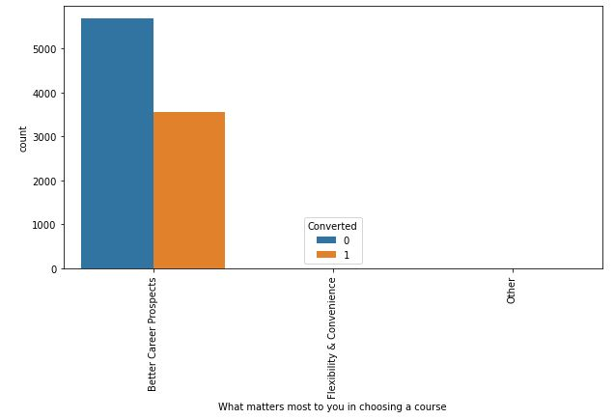
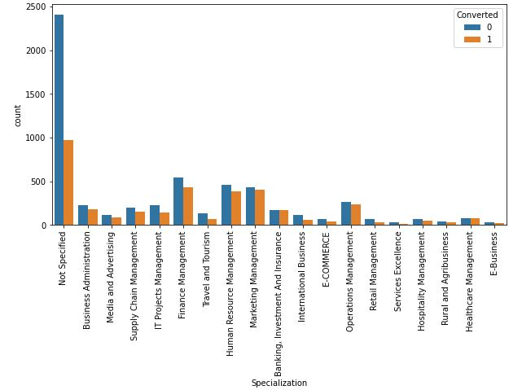

Slide 9
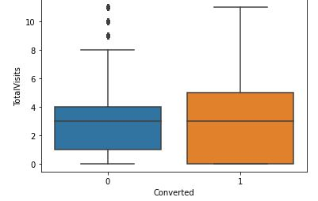
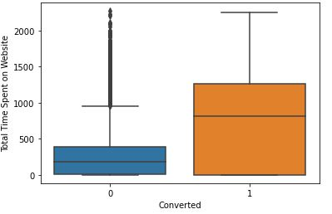
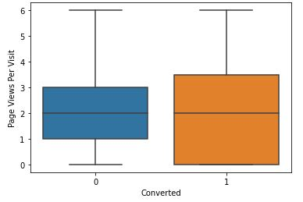

Slide 10
Model Building
Splitting the Data into Training and Testing Sets
The first basic step for regression is performing a train-test split, we have chosen 70:30 ratio.
Use RFE for Feature Selection
Running RFE with 15 variables as output
Building Model by removing the variable whose p- value is greater than 0.05 and VIF value is greater than 5
Predictions on test data set
Overall accuracy 92%

Slide 11
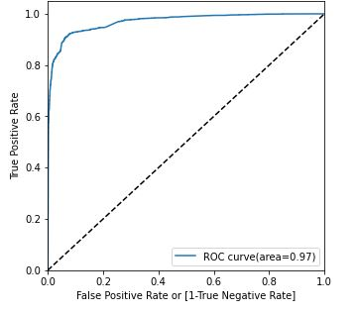
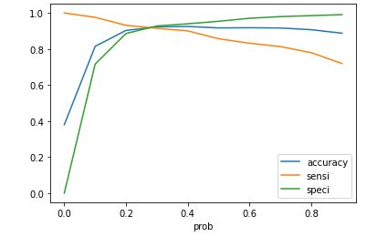
ROC Curve
Finding Optimal Cut off Point
Optimal cut off probability is that
probability where we get balanced sensitivity and specificity.
From the second graph it is visible that the optimal cut off is at 0.3.

Slide 12
Conclusion
Important features responsible for good conversion rate or the ones' which contributes more towards the probability of a lead getting converted are:
Lead Origin_Lead Add Form
Lead Source_Direct Traffic
Lead Source_Welingak Website
Last Activity_SMS Sent
Last Notable Activity_Modified
We got Accuracy, Precision and Recall for the both Training and Test set.
We got high recall score than precision score which we were exactly looking for.
The Model seems to predict the Conversion Rate very well.
Keeping these in mind the X Education can flourish as they have a very high chance to get almost all the potential buyers to change their mind and buy their courses.

